Slide 1

Hotel Operations Management System
Prepared For: Prepared By:
Mr. vidhyacharan bhaskar Ms. Nagalla, Santhi Sree
Data Modeling and Implementation Techniques CS457 ID:19568
Spring 2021
Northwestern Polytechnic University

Slide 2
AGENDA
Introduction
OBJECTIVES
EER Diagram
Relationships between Entities
Subclasses, Superclasses, and Inheritance
Specialization/Generalization
SQL → RELATIONAL ALGEBRA
Lab Part - SQL Commands
PRIMARY & FOREIGN KEY - REFERENCES
JOIN (Customer + Bookings)
REFERENCES

Slide 3
Introduction
Hotel Operations management system was defined as a system that enabled a hotel or group of hotels to manage front-office capabilities, such as
Booking reservations
Guest check-in/checkout
Room assignment
Managing room rates
and Billing.

Slide 4
OBJECTIVES
Front desk operations
Maintain Guest profiles
Manage Check-in/out Activities
Room management
Availability and occupancy management
Collection of payments

Slide 5
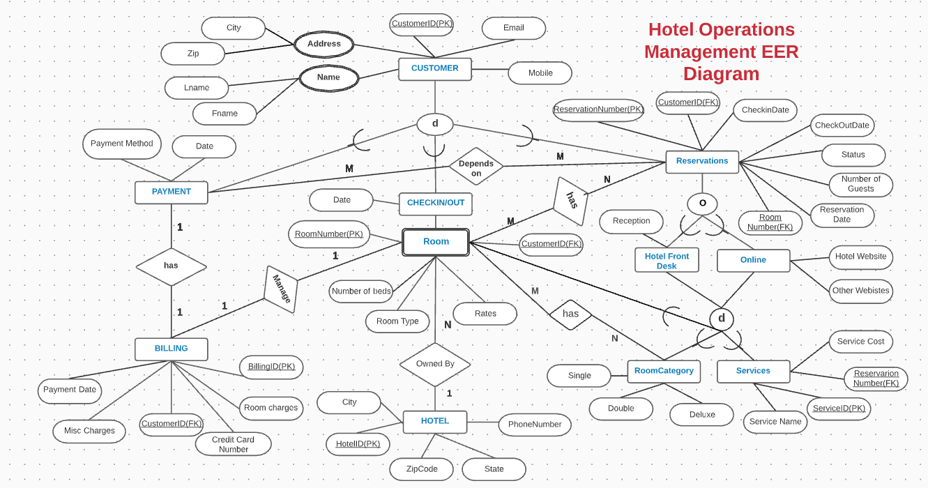

Slide 6
Relationships between Entities
Each entity (Customers,Services,Reservations,Rooms,Hotel) contains primary key and unique keys.
The entity Services,Reservations has binded with Customer ,Rooms entities with foreign key.
There is one to one and one -to-many relationships available between Reservations,Payments,Customers,Hotel.
Implemented indexing on each tables of Hotel management system tables for fast query execution.

Slide 7
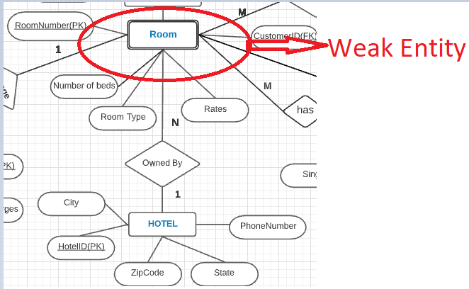
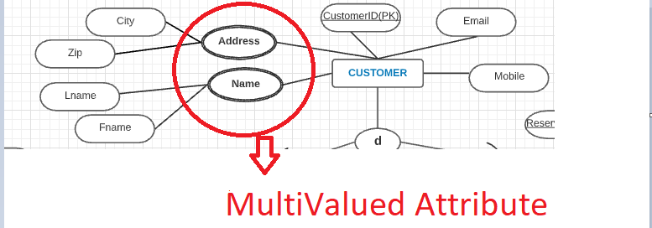
Weak Entity & Multi Valued Attribute
A weak entity is one that can only exist when owned by another one.For example: a ROOM can only exist in a BUILDING/Hotel.
A multivalued attribute of an entity is an attribute that can have more than one value associated with the key of the entity.

Slide 8
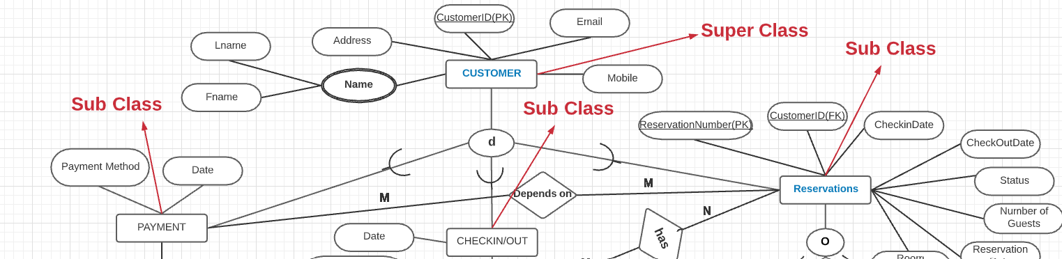


Subclasses, Superclasses, and Inheritance
• Sometimes, entities underneath an entity type can be classified to specific entities which have its own characteristics.
Example - Payment, Checkin/out, Reservations – All these entity types are considered as Customer activities, but each has its own unique attributes.

Slide 9
Subclasses, Superclasses, and Inheritance
• Payment, Checkin/out & Reservations are considered subclasses of “Customer”.
• “Customer” is the superclass of all the previous types of Customer Activities.
• We have a set of subclass/superclass connections – Example:
Payment/Customer,
Reservations/Customer
Checkin-Out/Customer

Slide 10
Subclasses, Superclasses, and Inheritance
• The connection between subclass and superclass is called inheritance.
• A subclass inherits all attributes of its superclass.
Example: Customer has a Payment, Checkin & Reservations
• Each subclass of Customer such as Reservations has also name, address, and Mobile which they inherit from the superclass Customer.

Slide 11
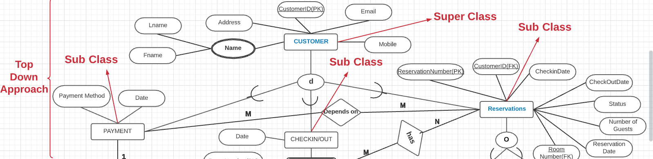
Specialization
Specialization is a process that defines a group entities which is divided into subgroups based on their characteristic.
It is a top down approach, in which one higher entity can be broken down into three lower level entity.

Slide 12
Specialization
• The process of defining subclasses of an entity type is called specialization.
• This entity type is called “superclass” of the specialization.
• Specialization distinguishes between subclasses based on a certain method:
1) {Payment, Checkin & Reservations}
• Classified based on Customer Activities.
2) {Hotel Front Desk,Online}
• Classified based on Reservation Types.

Slide 13
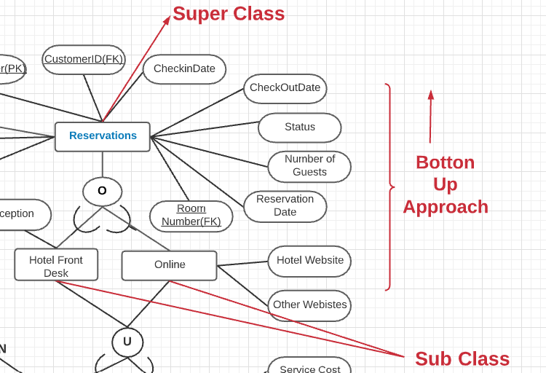



Generalization
It is a bottom approach, in which two lower level entities combine to form a higher level entity.
Generalization is the reverse process of Specialization.
It defines a general entity type from a set of specialized entity type.For example: Hotel Front Desk or Online Reservation can all be generalized to reserve a hotel as Reservations.

Slide 14
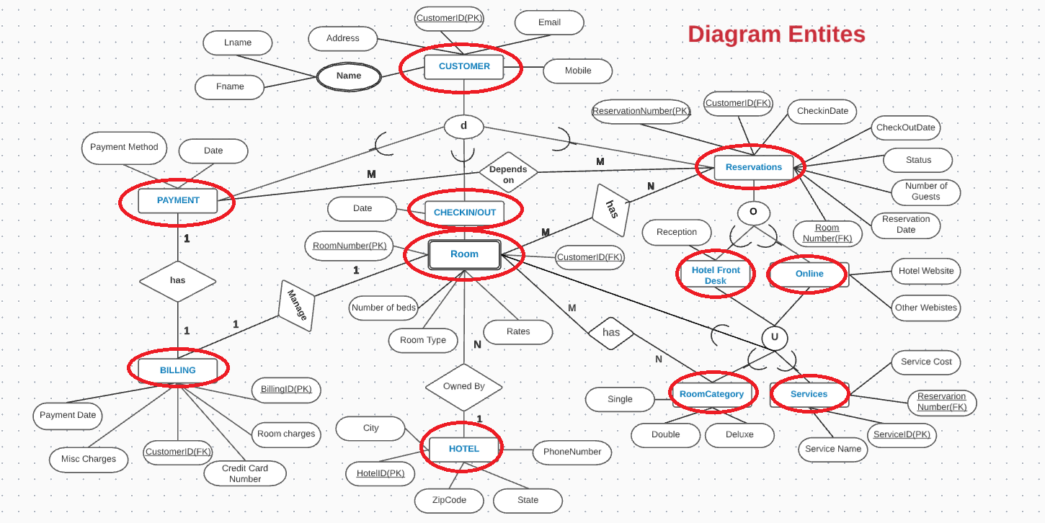

Slide 15
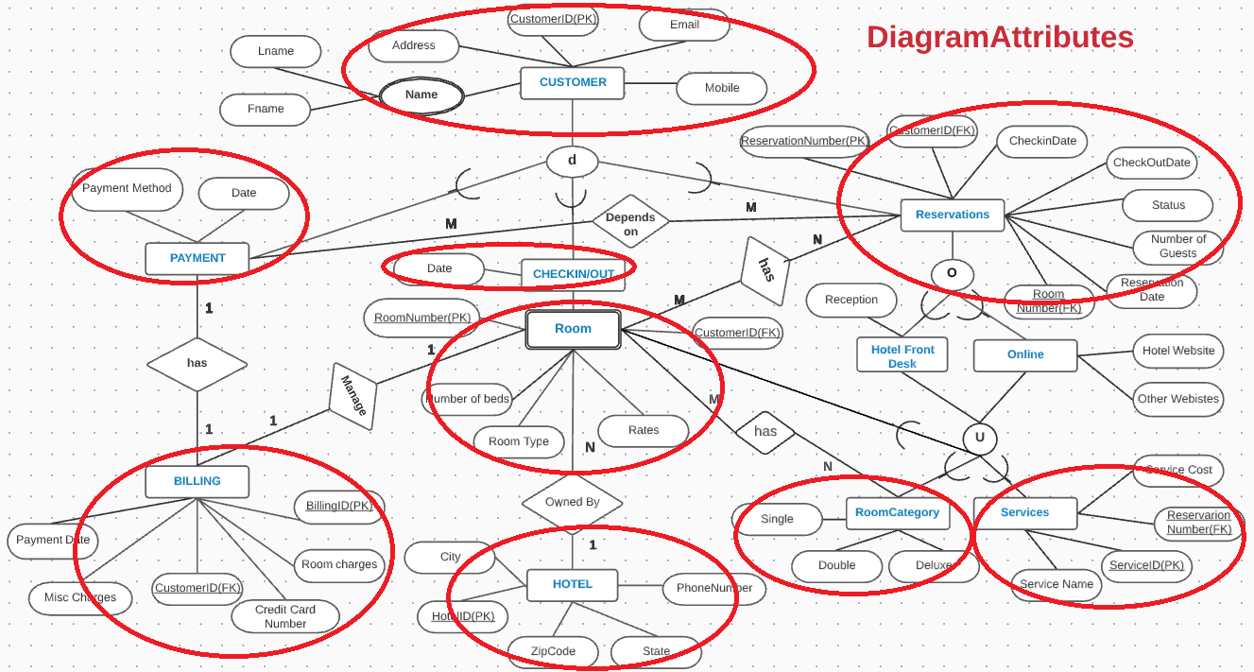

Slide 16
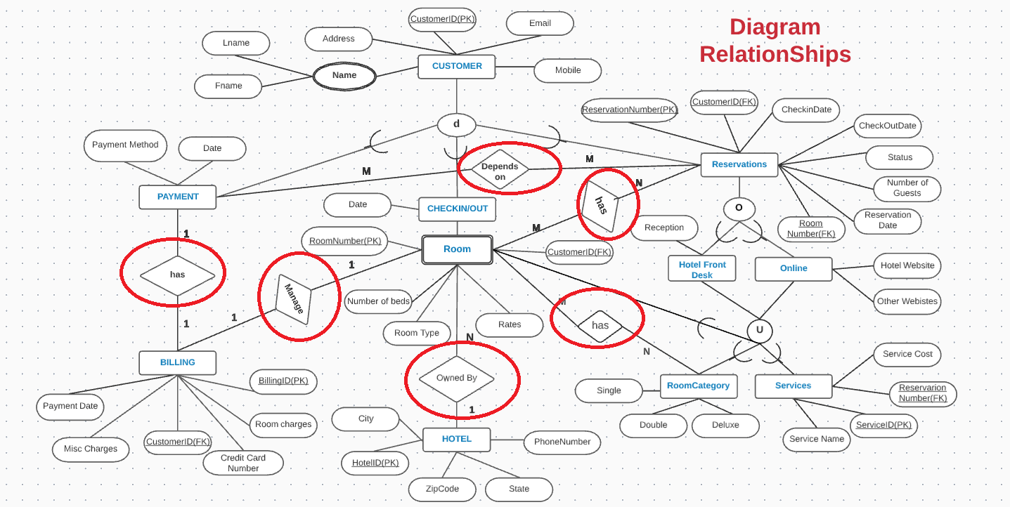

Slide 17

Disjointness Constraint
Specifies that all subclasses of a specialization must be disjoint.
In other words, if an entity belongs to one subclass of a specialization, then it cannot belong to another subclass of the same specialization.
Example: – {Payment,Checkin/Out,Reservations} is a disjoint specialization.
The disjointness is represented in EER using symbol.

Slide 18

Overlapping Subclasses
Reservations can do through Online or at Hotel front desk . However, a Reservations can also do through Online and at Hotel front desk at the same time that depends on discounts on the that day.

Slide 19
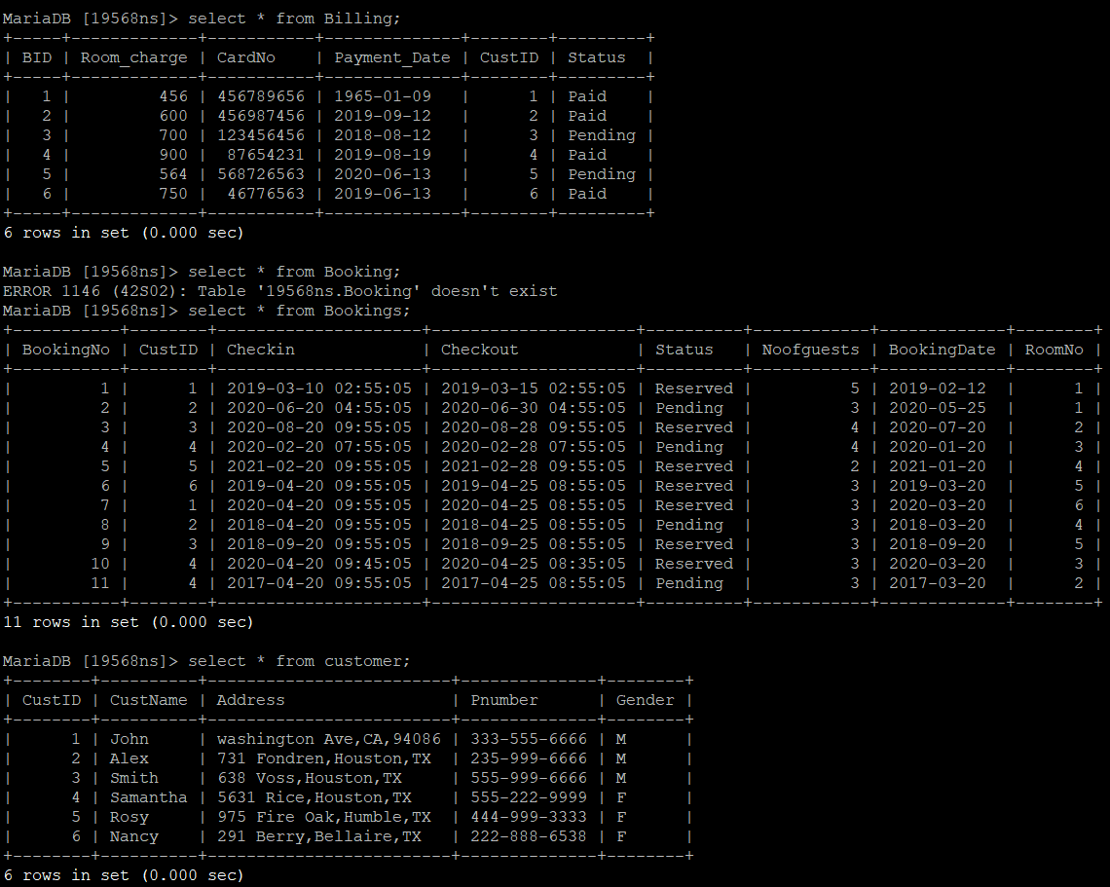
Hotel Operations Management - Tables

Slide 20

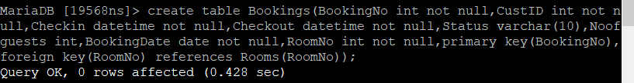
PRIMARY & FOREIGN KEY- REFERENCES

Slide 21
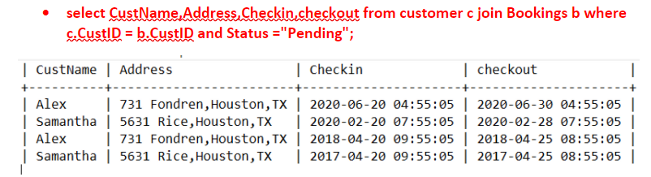
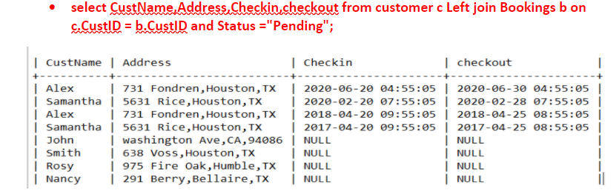
JOIN (Customer + Bookings)

Slide 22
SQL → RELATIONAL ALGEBRA
To retrieve the Customer ID and Customer name of all Customers whose Gender is Male.
(SQL Query)
select * from customer where CustID IN (select CUSTID from customer where Gender ='M');
Can write a single Relational algebra expression as follows.Must apply a select() and a project(π) operation.
π CustID,CustName( Gender=’M’ (Customer))
OR explicitly show the operations , giving a name to each intermediate relation:
Male_Customers←  Gender=M(Customer)
RESULT←πCustID,CustName(Male_Customers)

Slide 23
REFERENCES
Elmasri, R. and Navathe, S. (2017). Fundamentals of database systems. Boston [etc.]: Pearson.
https://en.wikipedia.org/wiki/Enhanced_entity%E2%80%93relationship_model
https://www.tutorialspoint.com/Extended-Entity-Relationship-EE-R-Model
https://www.geeksforgeeks.org/enhanced-er-model/

Slide 24
Thank you for your attention!
Any questions?

